Slide 1
6. Optimization Duality and sensitivity analysis
Laura Hervert Escobar

Slide 2
Duality
Every linear program has another linear program associated with it: Its ‘dual’
The dual complements the original linear program, the ‘primal’
The theory of duality provides many insights into what is happening ‘behind the scenes
It's like looking at the optimization problem from a different angle. While the original optimization problem (called the primal to separate from the dual) might not be 'efficiently' solved, the dual often is.
However, the catch is, the dual is not always useful: solving the dual does not always guarantee solving the original problem (called the primal).
Lucky for us, the dual is all we need in solving the interdiction problem.

Slide 3
Primal – Dual relationship
An important take away is the dual problem of a minimization problem is a maximization problem and vice versa. With that said, given any optimization problem of the form
Primal
Decision variables: x
max Z = cx
s.to Ax ≤ b n
x ≥ 0 m
Dual
Decision variables: y
min W = yb
s.to yA ≥ c m
y ≥ 0 n

Slide 4
Primal and Dual - Example Standard Algebraic Form
Primal
Dual
Max Z = 3x₁+ 5x₂
s. to
x₁ ≤ 4
2x₂ ≤ 12
3x₁+ 2x₂ ≤ 18
x₁,x₂ ≥ 0
Min W = 4y₁+ 12y₂+ 18y₃
s. to y₁+ 3y₃ ≥ 3
2y₂+ 2y₃ ≥ 5
y₁, y₂, y₃ ≥ 0

Slide 5
Primal and Dual - Example Matrix Form
Primal
Dual

Slide 6
Duality Theorem
The following are the only possible relationships between the primal and dual problems:
PRIMAL | DUAL
Feasible solution Bounded objective function (Optimal solution) | Feasible solution Bounded objective function (Optimal solution)
Feasible solutions Unbounded objective function (No optimal solutions) | No feasible solutions
No feasible solutions | No feasible solutions Unbounded

Slide 7

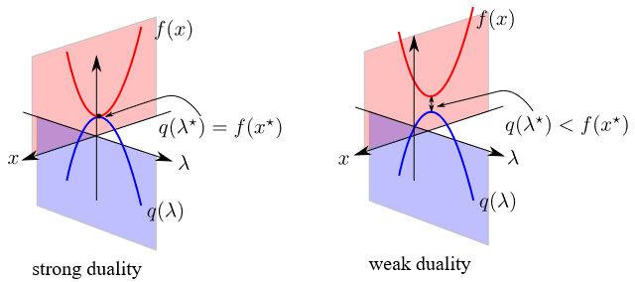
Relationships between Primal and Dual
Weak duality property If x is a feasible solution to the primal, and y is a feasible solution to the dual, then cx ≤ yb
Strong duality property If x* is an optimal solution to the primal, and y* is an optimal solution to the dual, then cx* = y*b
The concept of strong vs weak duality is the answer to the question "is the dual problem useful?". In case of strong duality, the dual problem is useful because the optimal value of the dual function is the optimal value of the primal problem itself. Then, solving the dual LP could give back the primal LP solution.

Slide 8
A More Detailed Look at Sensitivity
We are interested in the optimal solution sensitivity to changes in model parameters
Coefficients a_{ij}, c_{j}
Right hand sides b_{i}
If we change the model parameters, how does it affect
Feasibility?
If violated, then primal infeasible, but may be dual feasible
Optimality?
If violated, then dual infeasible, but may be primal feasible

Slide 9
Sensitivity Analysis
Reduced cost
Reduced cost, or opportunity cost, is the amount by which an objective function coefficient would have to improve (so increase for maximization problem, decrease for minimization problem) before it would be possible for a corresponding variable to assume a positive value in the optimal solution.
In the case of a minimization problem, "improved" means "reduced". So, in the case of a cost-minimization problem, where the objective function coefficients represent the per-unit cost of the activities represented by the variables, the "reduced cost" coefficients indicate how much each cost coefficient would have to be reduced before the activity represented by the corresponding variable would be cost-effective.
In the case of a maximization problem, "improved" means "increased". In this case, where, for example, the objective function coefficient might represent the net profit per unit of the activity. The reduced cost value indicates how much the profitability of the activity would have to be increased in order for the activity to occur in the optimal solution. The units of the reduced-cost values are the same as the units of the corresponding objective function coefficients.

Slide 10
Sensitivity Analysis
A shadow price value is associated with each constraint of the model. It is the instantaneous change in the objective value of the optimal solution obtained by changing the right hand side constraint by one unit.
In a maximization problem the shadow price associated with a resource tells you how much more profit you would get by increasing the amount of that resource by one unit.
In a minimization problem the shadow price associated with a resource tells you how much more the cost is reduced by increasing the amount of that resource by one unit.
If the RHS is decreased, the shadow price is the rate at which Z (or C) is impaired
The shadow price may change to a different value outside this allowable range. The shadow price information does not tell us how the optimal solution mix (i.e., the values for decision variables X1, X2, etc.) changes.

Slide 11
Let´s check at Python

